Slide 1


Database Management Final Project
Team Upsilon
Claire Duchene, Jessy Sun, George Wei, and Michael Uhrig

Slide 2
Understanding
Overview
What’s the meaning of readmission?
Patient admission to a hospital within 30 days after being discharged from an earlier hospital stay
Why do we need to study the factors influencing readmission within 30 days?
Benchmark by the Centers for Medicare & Medicaid Services (CMS): the 30-day readmission rate
Save substantial cost and time on readmission
Intro
Interpretation
Implementation
Analysis
Conclusion
Definition
2 Questions
Modeling
Star schema
ETL
Visualization
Conclusion
Thoughts

Slide 3
Introduction
Using the data provided to us by Bon Secours we attempted the observe the effect of numerous factors on patients’ readmission rate to a hospital within 30 days
Essentially, we want to know what causes readmission?
We aimed to answer three main questions:
Are readmission rates affected by patient gender?
Are readmission rates affected by marital status?
What does admission type tell us about a patient? (Elective vs. Emergency)
Ultimately, we found that there is some observable correlation between patient gender and marital status, and significant correlation between admission type and readmission rates

Slide 4
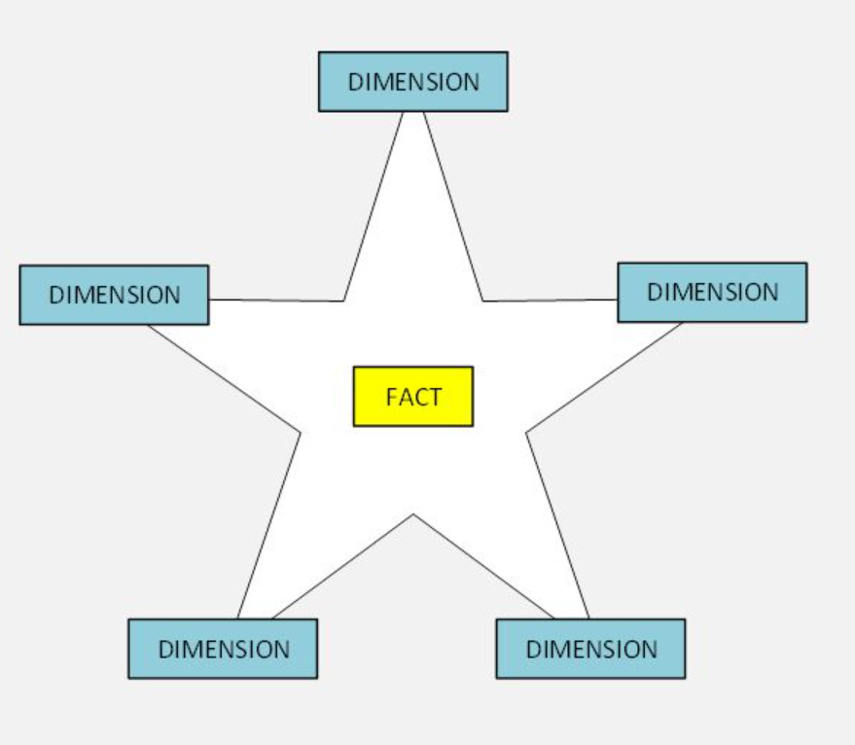
ERD Diagram
Description and justification of modeling approach
Star schema
Fact table:
(measures about our subject, readmission)
Each row: a inpatient claim row
Dimensions:
(descriptions related to readmission)
Provider
Diagnosis related group
Patient
Location
Admission type and sources
Diagnosis
Time

Slide 5
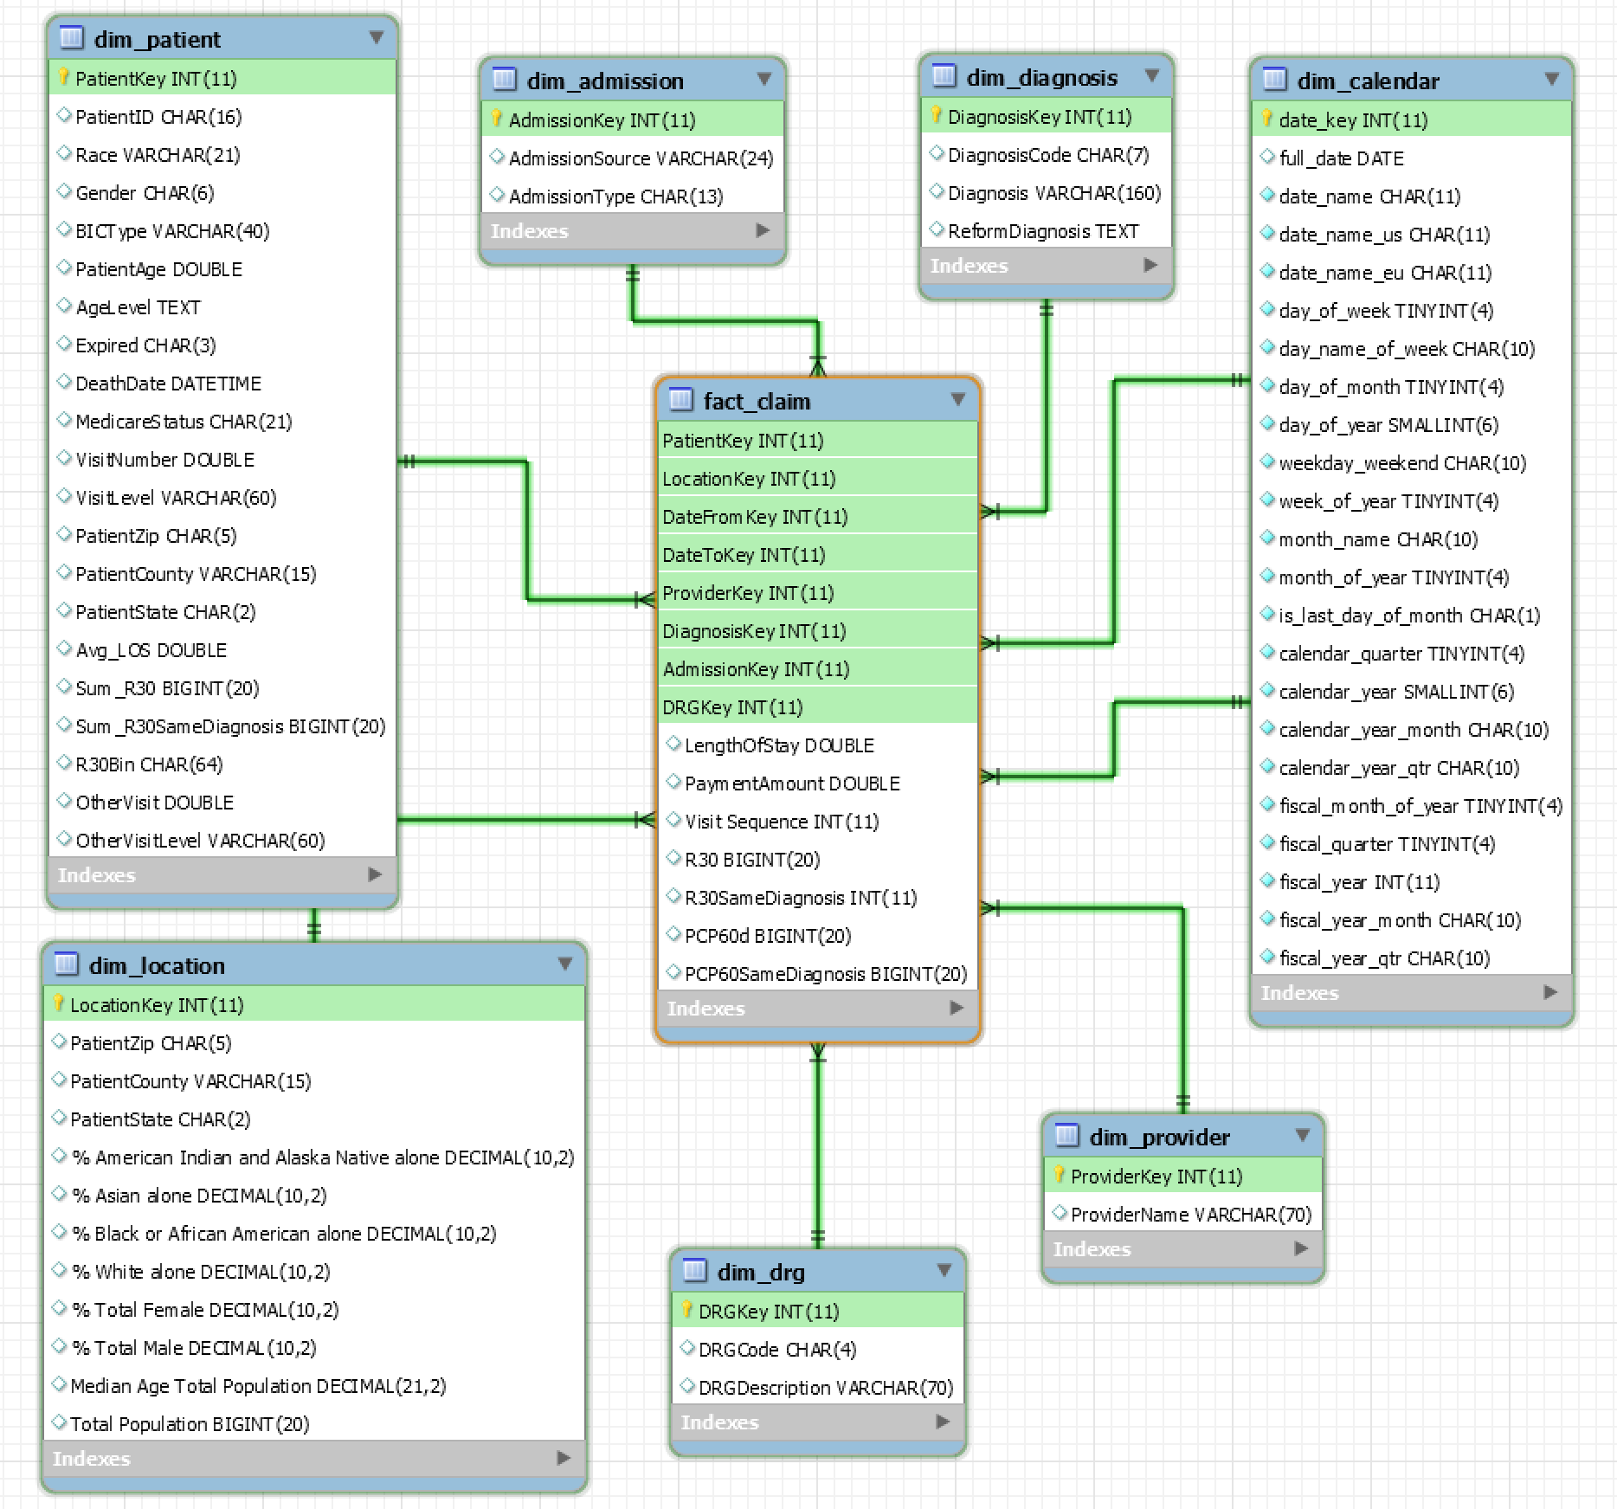
Schema

Slide 6
ETL Process
ETL: extraction-transformation-load infrastructure
Extraction
(Extracting useful data from operational data sources)
From operational data sources
By Bon Secours: two high-level files and three detailed files (Richmond & Hampton Roads, 2016 to 2017).
Transformation
(Transforming data to conform to the structure needed for analysis)
Merge high-level data files → clean it (Alteryx)
Build dimensions (Alteryx & MySQL)
Build the fact table (Alteryx)
Supplement fact table by principal care physician (PCP) related data (detailed data files).
Load
(loading the transformed and quality assured data into the data warehouse)
Alteryx to MySQL
Notes:
extracting useful data from operational data sources
transforming such data to conform to the structure of target data warehouse
loading the transformed and quality assured data into the data warehouse.

Slide 7
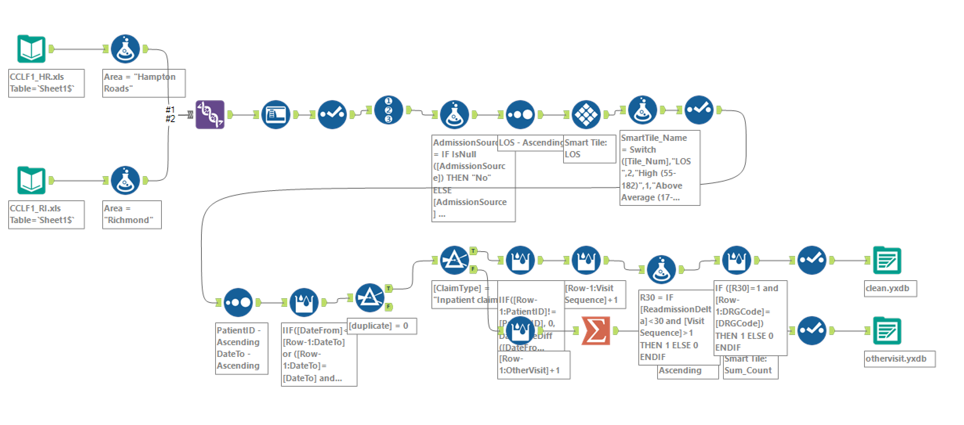
ETL Process Cont’d
Data Cleaning (Alteryx 1)
131,070 records
(high level HR & RI)
14,633 duplications
116,437 records remaining
Filter “inpatient claim”
4,443 inpatient claims
Readmission Delta
Visit Sequence
R30

Slide 8
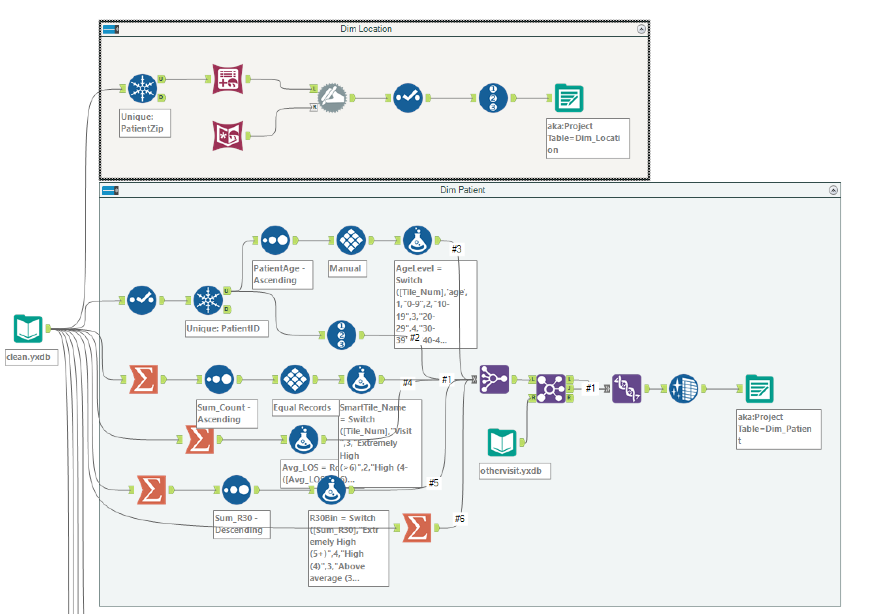
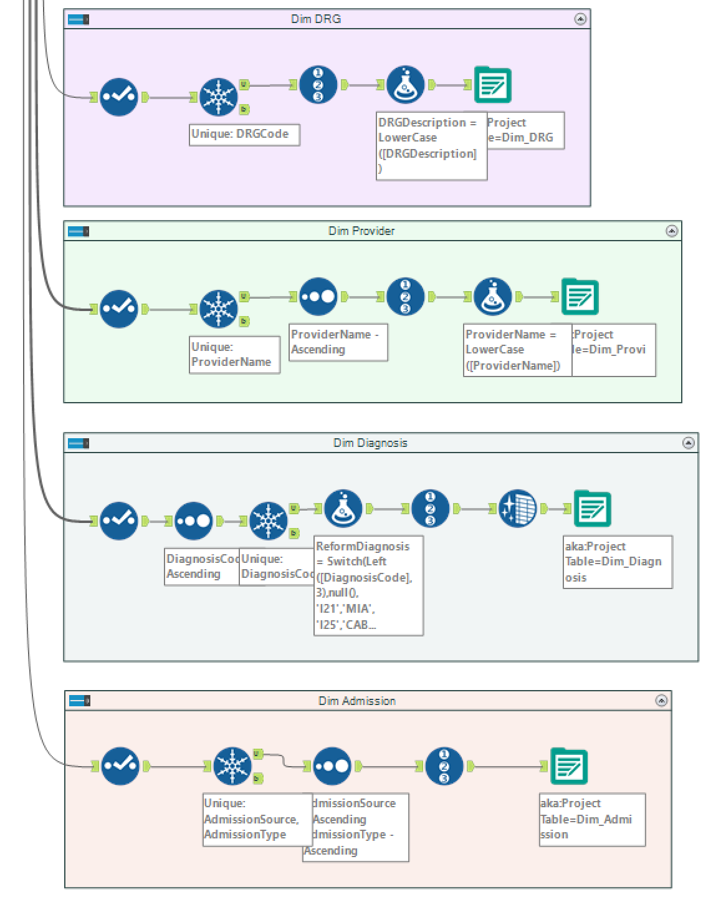
ETL Process Cont’d
Build dimensions (Alteryx 2 & MySQL)
Input
Cleaned data
Dimensions:
Provider
Diagnosis related group
Patient
Location
Admission type and sources
Diagnosis
Time

Slide 9
Location & Patient Dimension
Patient zip code → merged with US census 2010 database
% race
% gender
Total population
Patient
Basic (age, gender, MDCR, BIC)
R30
R30SameDiagnosis
No. of other types of claims
Creating the dimensions...
Notes:
(how many time he or she was admitted by this hospital)
ihe number of other types of claims he or she had during this period, and the bin for that
number of times readmitted within 30 days,
ihe number of other types of claims he or she had during this period, and the bin for that

Slide 10
Other Dimensions
Diagnosis-related group (DRG)
DRG description
DRG codes
Provider dimension
Admission dimension
Admission source: referral, transfer, law
Admission type: elective, emergency, urgent
Calendar dimension
Diagnosis dimension
Diagnosis Code
Diagnosis
Reform Diagnosis
Acute myocardial infarction – AMI
Heart failure-HF
Chronic obstructive pulmonary disease- COPD
Coronary artery bypass grafting – CABG
Stroke - Stroke
Notes:
Provider dimension, it contains the provider names (centers or hospitals).
Calendar dimension, it enables us to do time related analysis such as when this readmission happened, what were the starting and ending date of this claim, and in which time pattern does readmission happen more often. Specifically, only this dimension is built by existing SQL files rather than on Alteryx.

Slide 11
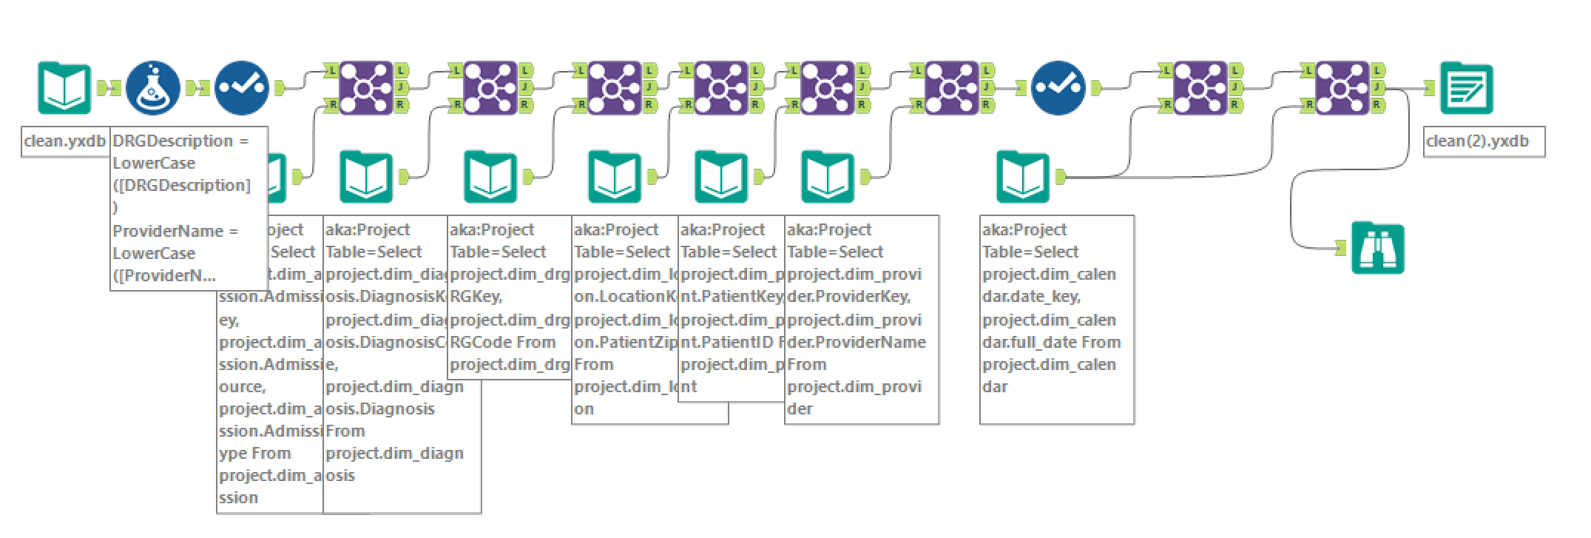
ETL Process Cont’d
Building the fact table… Alteryx 3

Slide 12
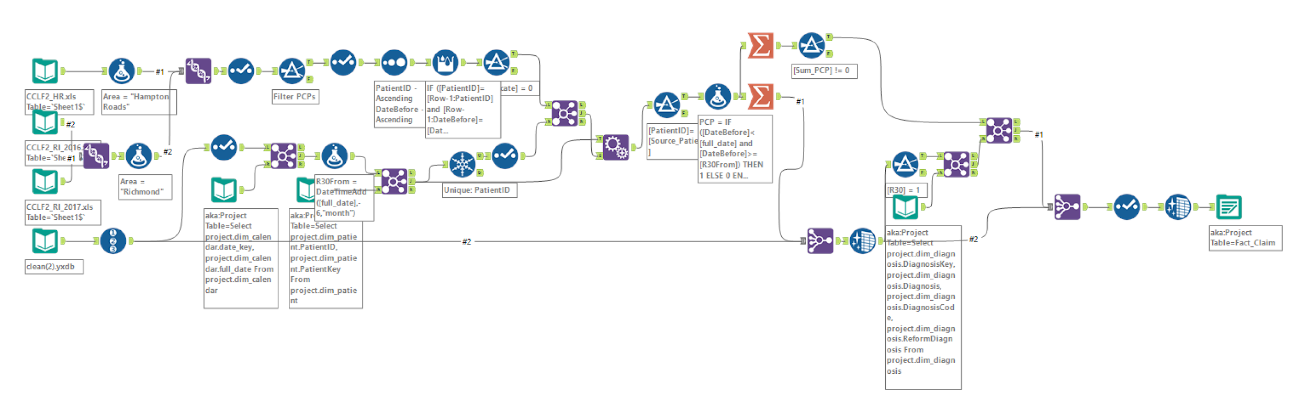
ETL Process Cont’d
Combining the data from the “high-level” and “detailed” files
PCP6M
PCP6MSameDiagnosis

Slide 13
Queries & Visualization
We queried our data based on our aim to answer our three research questions, regarding the effect of patient gender, marital status, and admission type on readmission rate
We then visualized these queries in Tableau
Some of the things we queried for include:
Readmission rate for a certain diagnoses, and age- grouped by gender
Readmission rate, length of stay, average patient age, and number of times patient saw their PCPin the last 60 days- grouped by marital status
Readmission rate versus the average number of times a patient visited their PCP 60 days prior- grouped by patient gender
Readmission rate, and related statistics- grouped by admission type

Slide 14
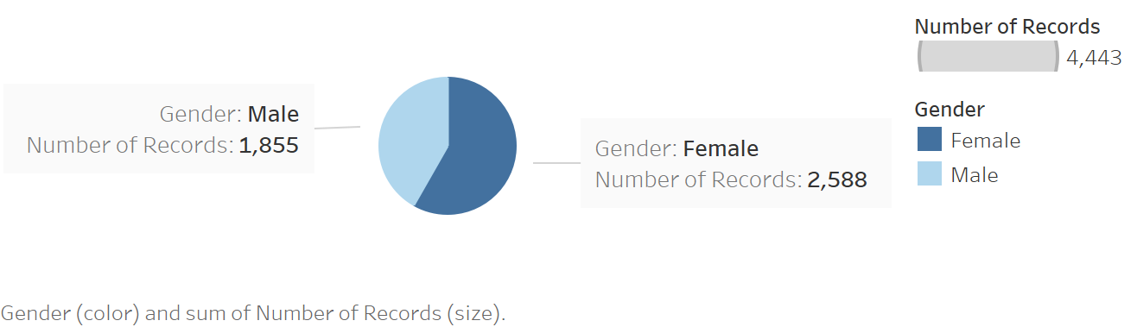
Research Question 1
Whether gender affects readmission rate?
Different number of in-patient claims
4,443 records are in-patient claims (116,437 non-duplicate records) → 60 % incurred by female
Graph *1: Total number of in-patient claims by gender

Slide 15
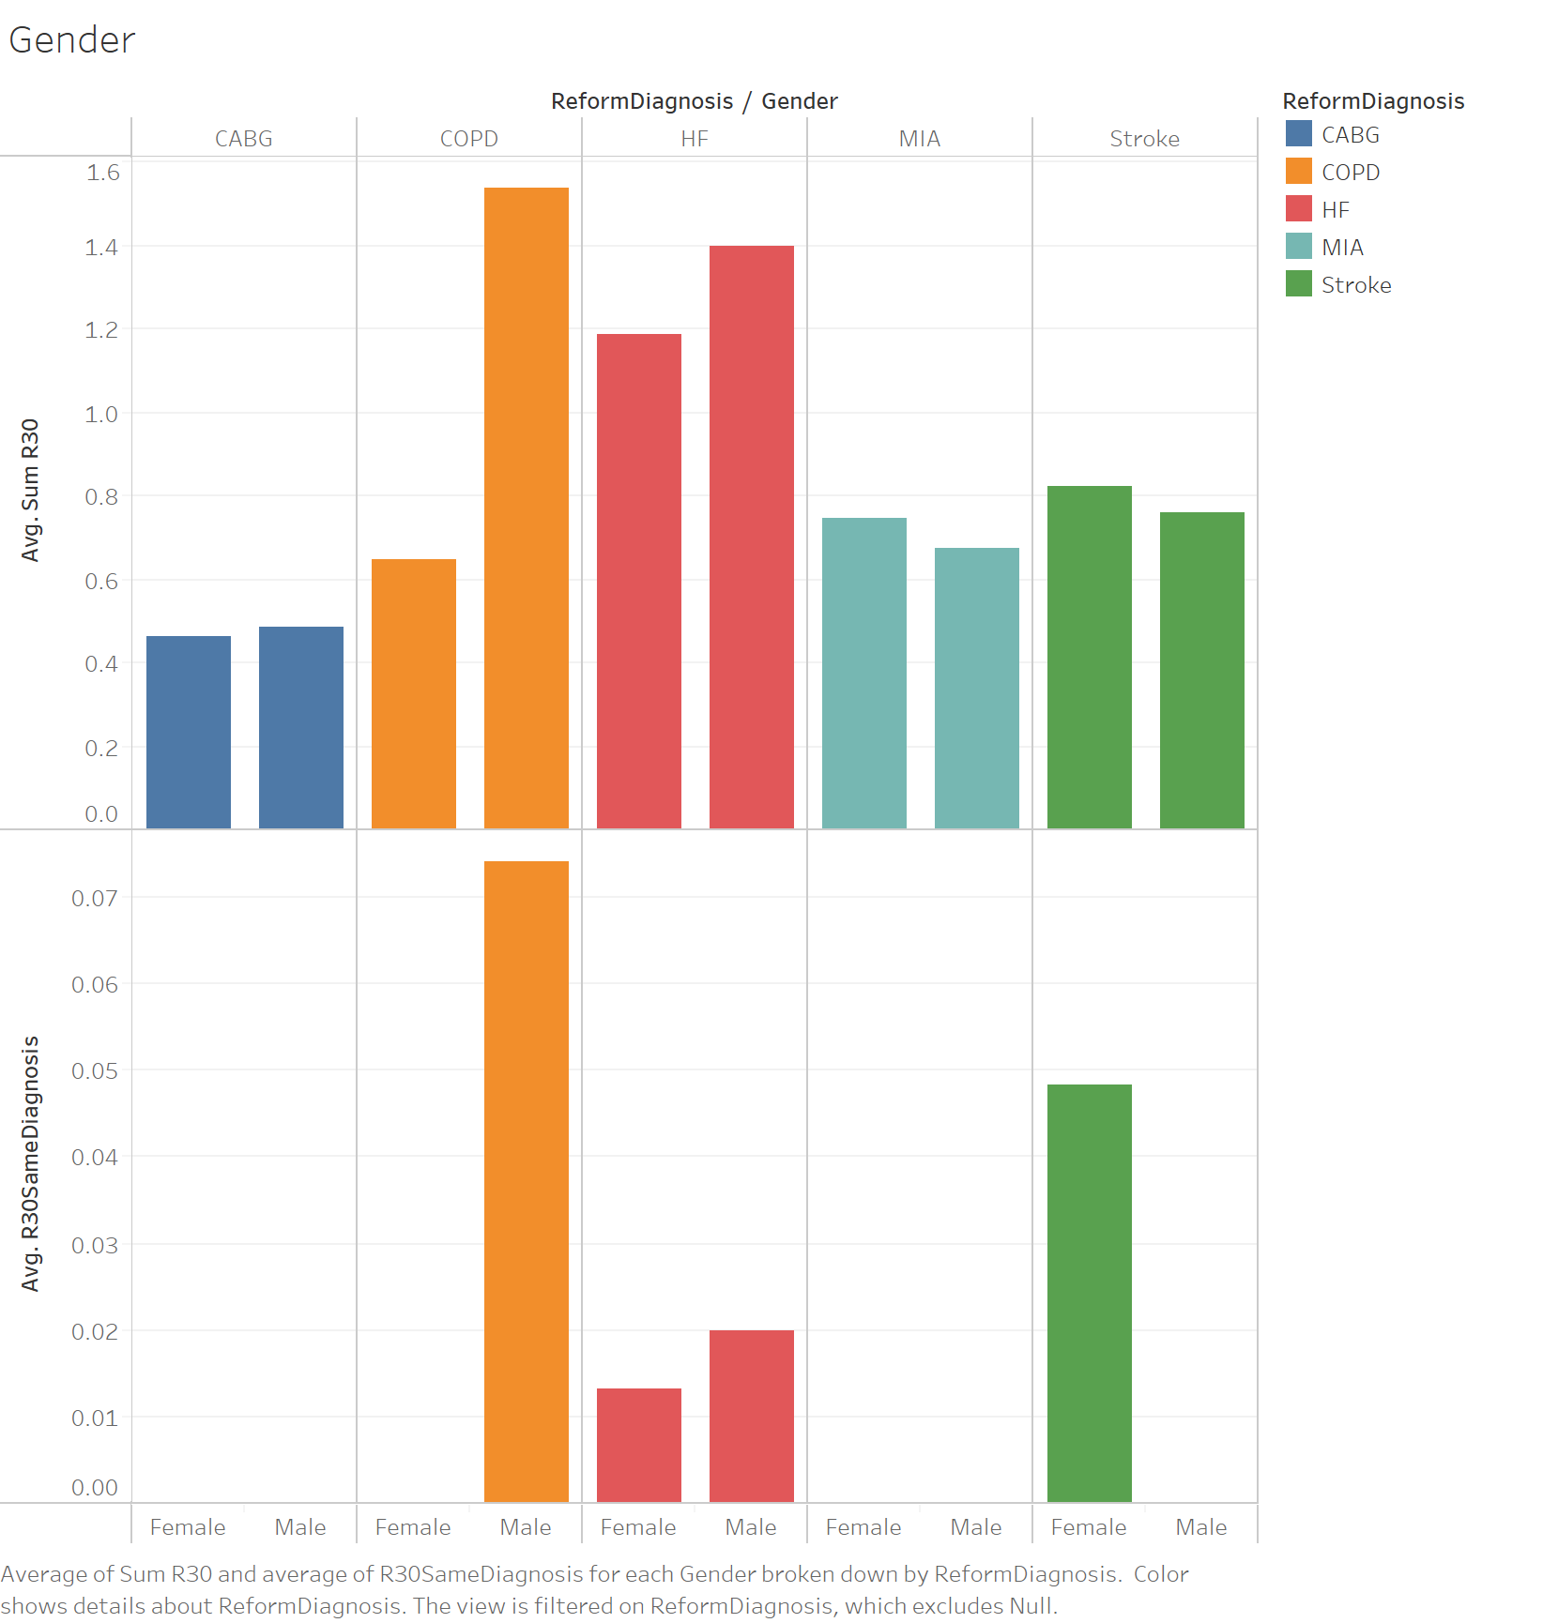
Different readmission level
Likelihood of readmission
Female: higher for AMI and Stroke diagnoses
Male: higher for COPD and HF diagnoses
Readmission by same diagnosis within 30 days?
Only males got admitted for the same diagnosis as previously under COPD
Only female patients got admitted for the same diagnosis as previously for Stroke
Both may be readmitted for the same diagnosis of heart failure
Hospitals are doing well to prevent the readmission with same diagnoses of AMI and CABG
Suggestion
Study reasons (different attitudes or physiological constitution between men and women)
Different measures to reduce readmission with same diagnoses of COPD, HF, and Stroke.
Notes:
6. Acute myocardial infarction – AMI
7. Heart failure – HF
8. Chronic obstructive pulmonary disease – COPD
9. Coronary artery bypass grafting – CABG
10. Stroke – Stroke

Slide 16
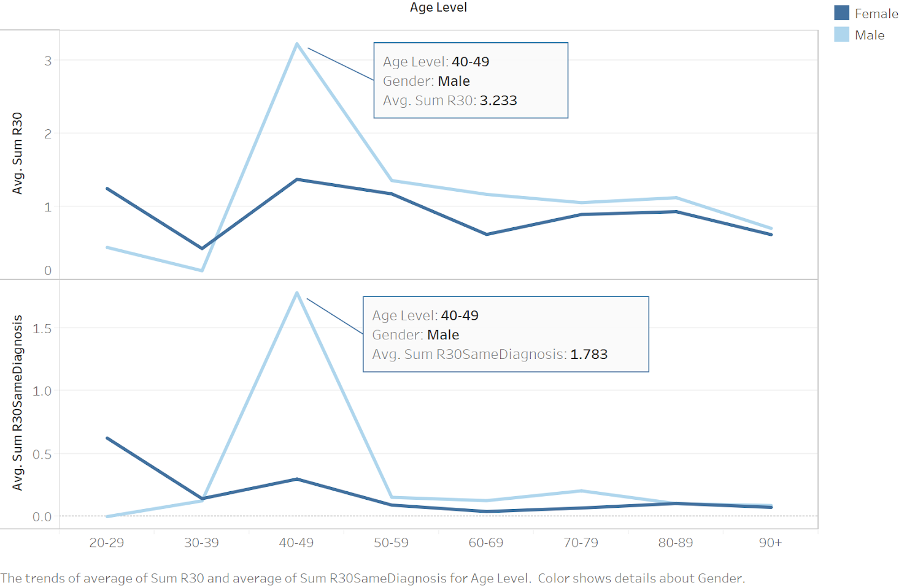
Average number of readmissions among different age groups
Graph above: average readmission
Graph below: average readmission with the same diagnosis
40-49 group: highest average readmission number
Of the 137 readmissions in this group,
77 (56%) are female
30-39 group: lowest average readmission
Suggestion:
Special attention to 40-49
(Communication with PCP)
Further analysis needed
Graph *2: Average number of Readmission among different age groups by gender

Slide 17
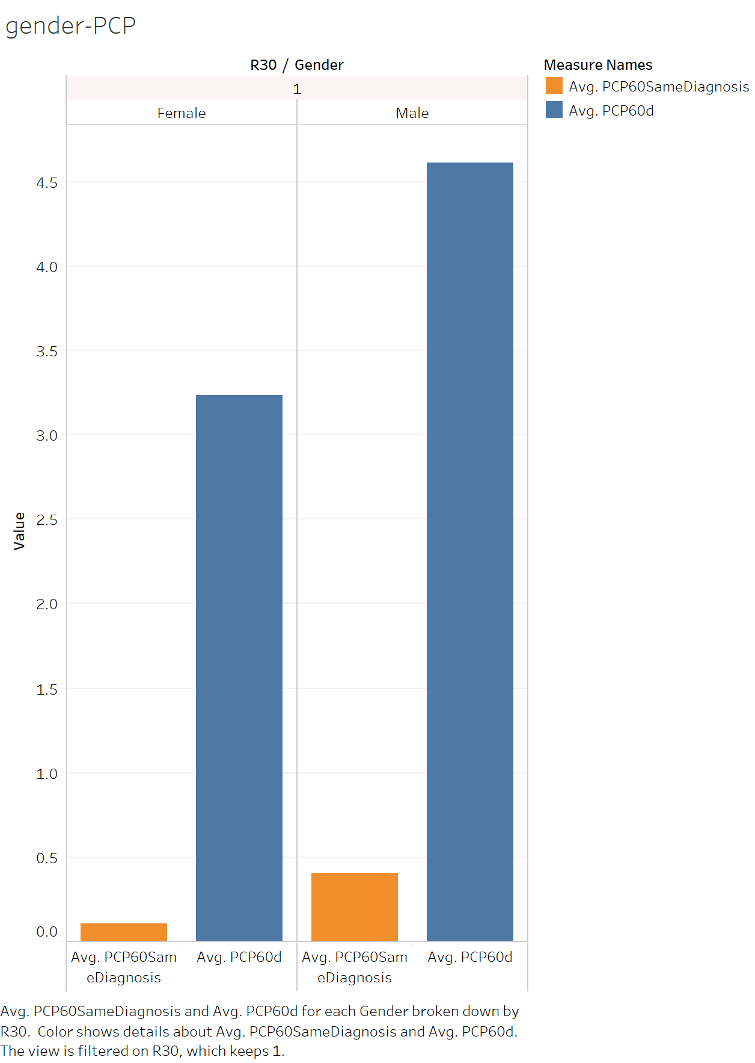
Different PCP visit numbers
This table reveals that for all the readmissions within 30 days:
The average number of times the patient visited their PCP (primary care physician) within 6 months before this readmission
Average number of times the patient visited their PCP within 6 months with the same diagnosis
→ Males are more likely to have visited their PCP 6 months before a readmission

Slide 18
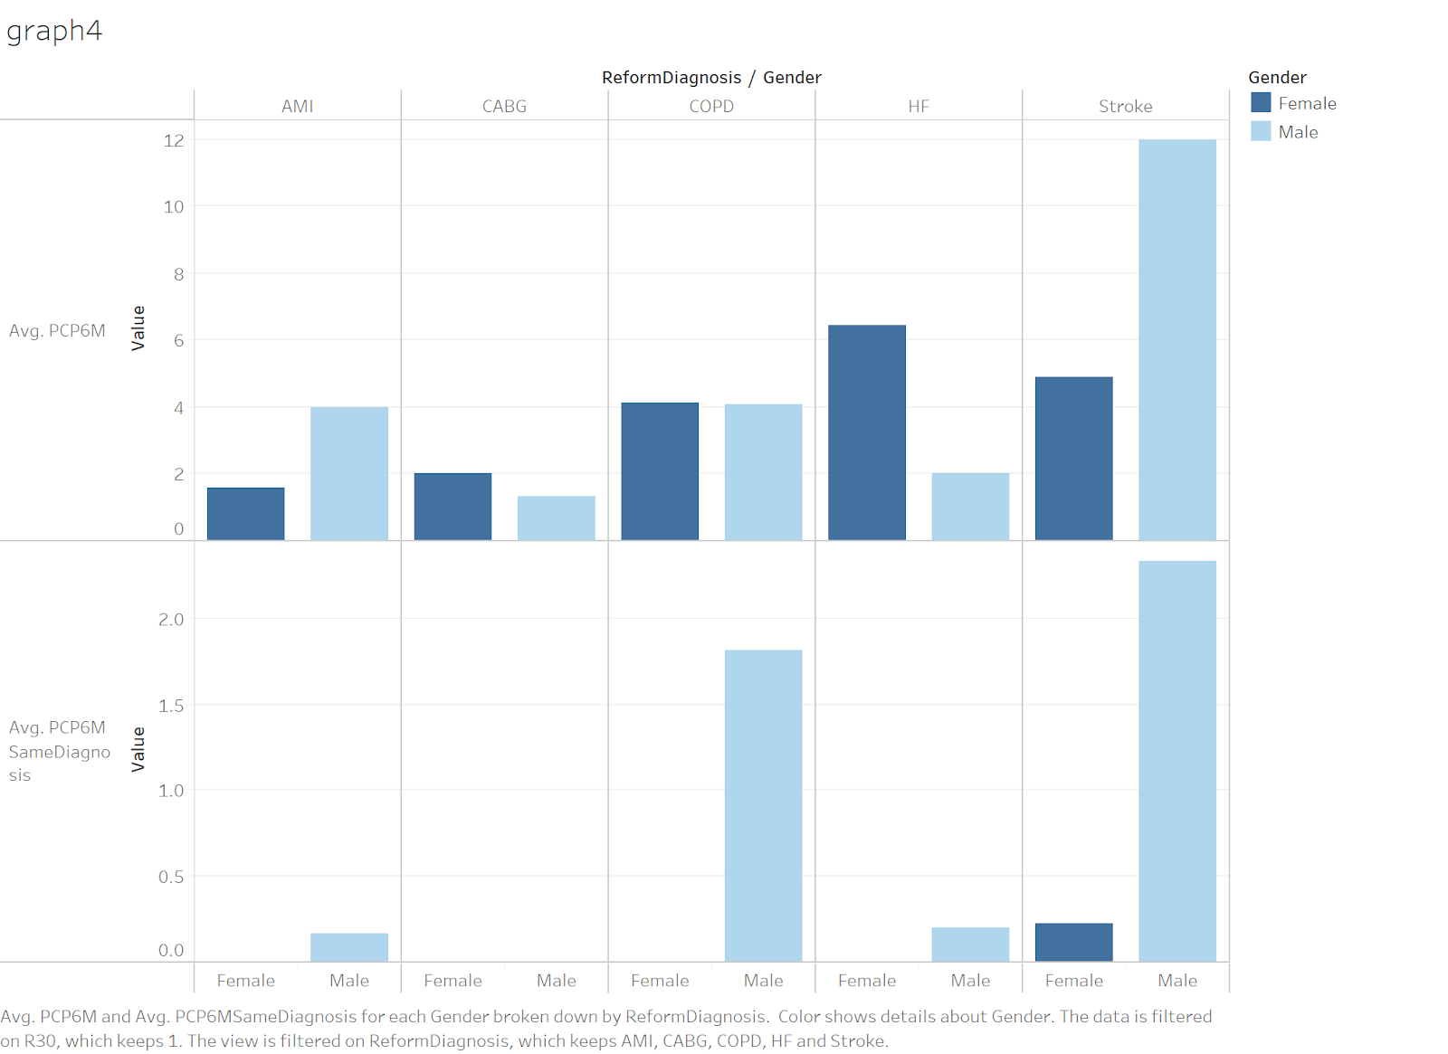
Different PCP visit numbers
For Chronic Obstructive Pulmonary Disease
Males: visit PCP for average 1.75 times for the same diagnosis in last 6 months
Females: never
For stroke
Males: visit PCP for average 2.3 times for the same diagnosis in last 6 months
Females: average 0.25 times
Notes:
For heart disease readmission
o Male: visit PCP for average 1.75 times for the same diagnosis in last 6 months
o Female: never
For stroke
o Male: visit PCP for average 2.3 times for the same diagnosis in last 6 months
o Female: average 0.25 times

Slide 19
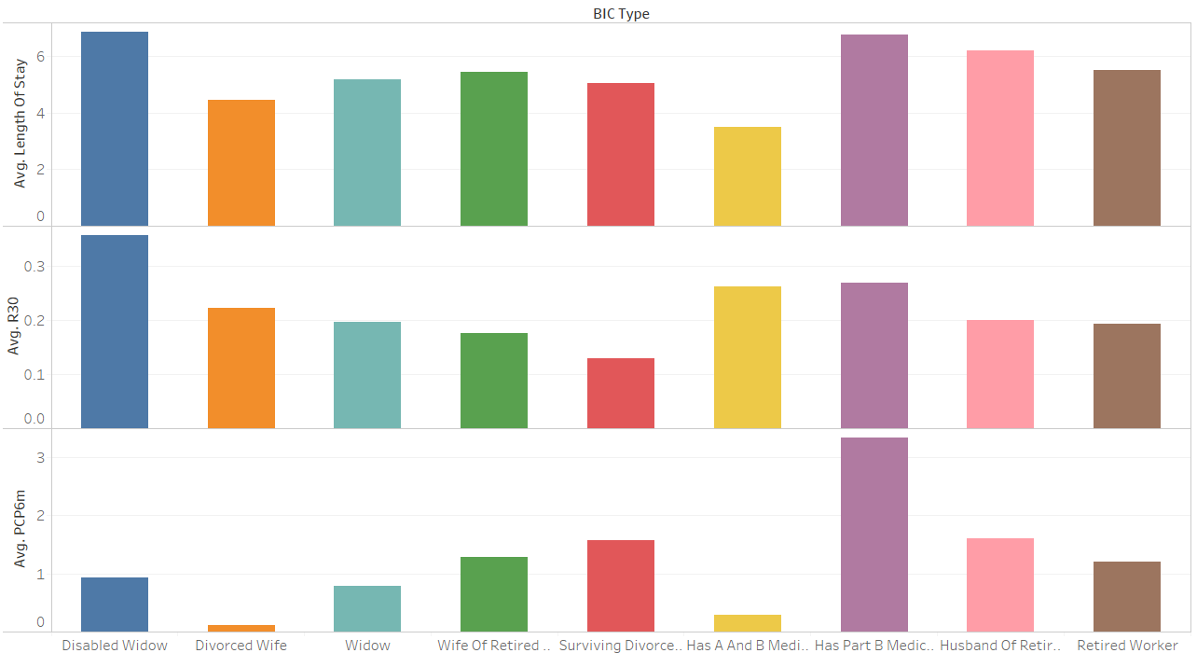
Research Question 2
Notes:
Disabled Widow has the highest length of stay, highest R30, a fairly low pcp6m, and also not on this graph, the lowest average age.
Divorced Wife and Widow also have very low average pcp6m.
Retired Worker is by far the largest group, very average.

Slide 20
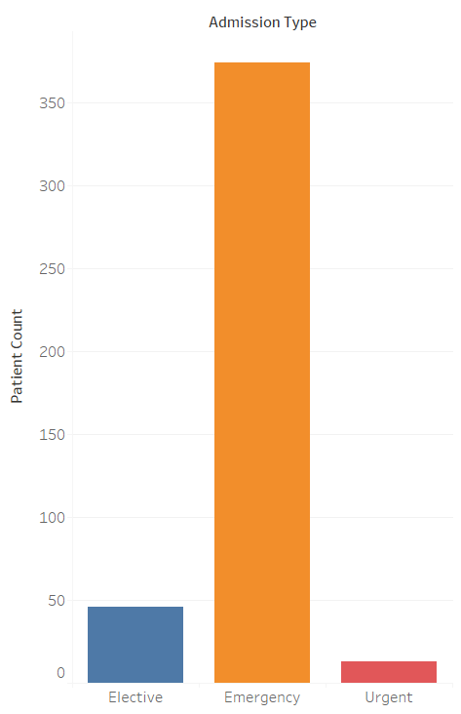
Research Question 3
Acute myocardial infarction
Heart Failure
Chronic obstructive Pulmonary Disease
Coronary Artery Bypass Grafting
Stroke
Notes:
Most of the admissions for AMI, HF, COPD, CABG, and stroke are emergency cases, about 90%, which is much higher than total rate (~75%).

Slide 21
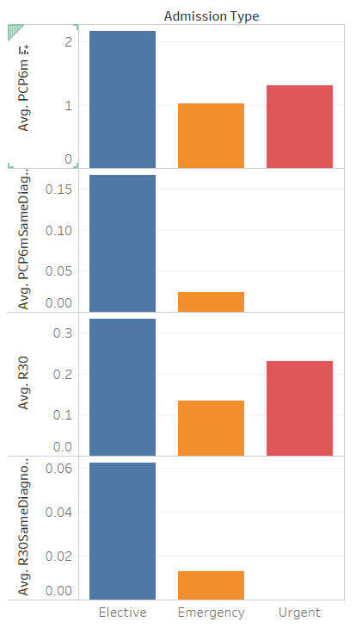
Notes:
Looking at the average PCP visits 6 months beforehand and the average readmissions within 30 days, we can see that patients who were admitted electively were a lot more likely to have visited their PCP before and also be readmitted within 30 days, especially with the same diagnosis.

Slide 22
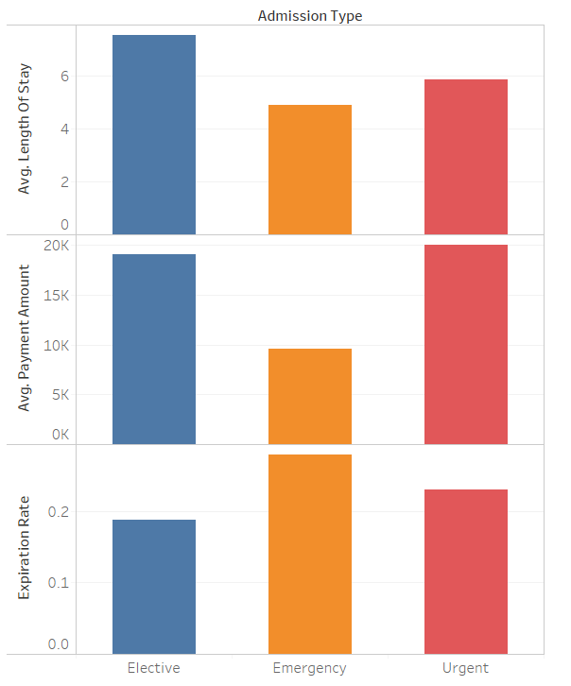
Notes:
Elective patients an average of 2 days longer, pay an average of $10,000 more, but have a 10% lower expiration rate. We can divide these two groups into the cautious patients, who go to the hospital more electively, visit their pcp much more often, are more aware of their issue, and therefore 10% less likely to expire, and the patients that go to the hospital only when there is an emergency and don’t visit their PCP that often, and try to stay away from hospitals. These are two broad categories, nobody fits totally into one or the other, but with more data, they can help determine why a patient is being readmitted. We also analyzed admission based on age, race, medicare status, and zip code, and did not find anything significant, so it is currently difficult to distinguish these groups.

Slide 23
Conclusion
Ultimately we came to several interesting conclusions after observing the data:
Those who were divorced or widowed were far more likely to be readmitted within 30 days than those who were married
The widowed group also had a larger average length of stay in addition to being younger (70 - average age) on average than most other patients readmitted
Men and women display different patterns regarding their readmission and frequency of visits to their PCP for the same diagnosis
Women and men are readmitted in different rates for different diagnoses
Men are more likely to see their PCP prior to readmission
Women are more likely to file an in-patient claim
Patients can be broken up into two groups; cautious and less cautious
Cautious patients go to the hospital before an emergency, visit their PCP more often, and stay longer
Less cautious patients are less likely to visit their PCP and try to stay away from the hospital
Hard to differentiate between these two groups

Slide 24
Takeaways
There were many detailed steps in this project but here were some of our takeaways:
Combining the detailed data with the high-level proved to be one of the hardest challenges because
It was also difficult to use a different modeling approach than the professor
Nothing in this project was particularly easy, but building the dimensions in Alteryx was very direct and we are familiar with the process
Additionally, it was interesting to visualize the data in Tableau
We learned how to handle real data and even merge two databases!
We also learned that there re a lot of frustrating limitations when working with real data and the processes of collecting and cleaning it is very difficult
Next time we do a project like this, we would try to obtain data regarding patient communication with their PCP, and also find an external source of data in order to measure the effect of income level on readmission rate

Slide 25

Merry Christmas!
Team Upsilon
Claire Duchene, Jessy Sun,
George Wei, and Michael Uhrig

